Slide 1
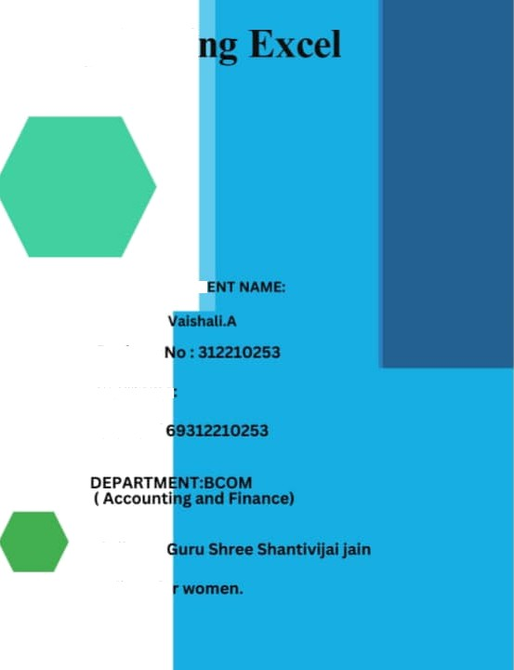

Employee Data Analysis usi
STUD
Regiscer
username
asunm13
College :
college fa

Slide 2
PROJECT TìTLE
Employee Performance Analysis using Excel

Slide 3



AGENDA
Pi obleni Statement
Project Overview I.End Users
Our Solrltioli and
Proposition
Dataset Description 6.Modelling Approach
Results and Discussion
Conclusion

Slide 4

PROBLEM STATEMENT
Analysing employee performance to track their working skills and to motivate the low level employees by various tasks .
To track the performance and give rewards to
improve the current performance.

Slide 5

PROJECT OVERVIEW
In this project we known about the eivlployees how they perforitt by various 3iapll and pivot table
Employee performance analysis is important to
identify the performance level toward the project and improve their level by assigning itew taks to emerge themselves

Slide 6

WHO ARE THE END USERS?
Employees
Organisations
Employers

Slide 7


OUR SOLUTION AND ITS VALUE PROPOSI
FilŁering — remove missing
Charts — visualizaŁion repoŁs
PivoŁ Łabe — summary Conditional formaŁŁing — idenŁify
missing
Formula - performance level

Slide 8
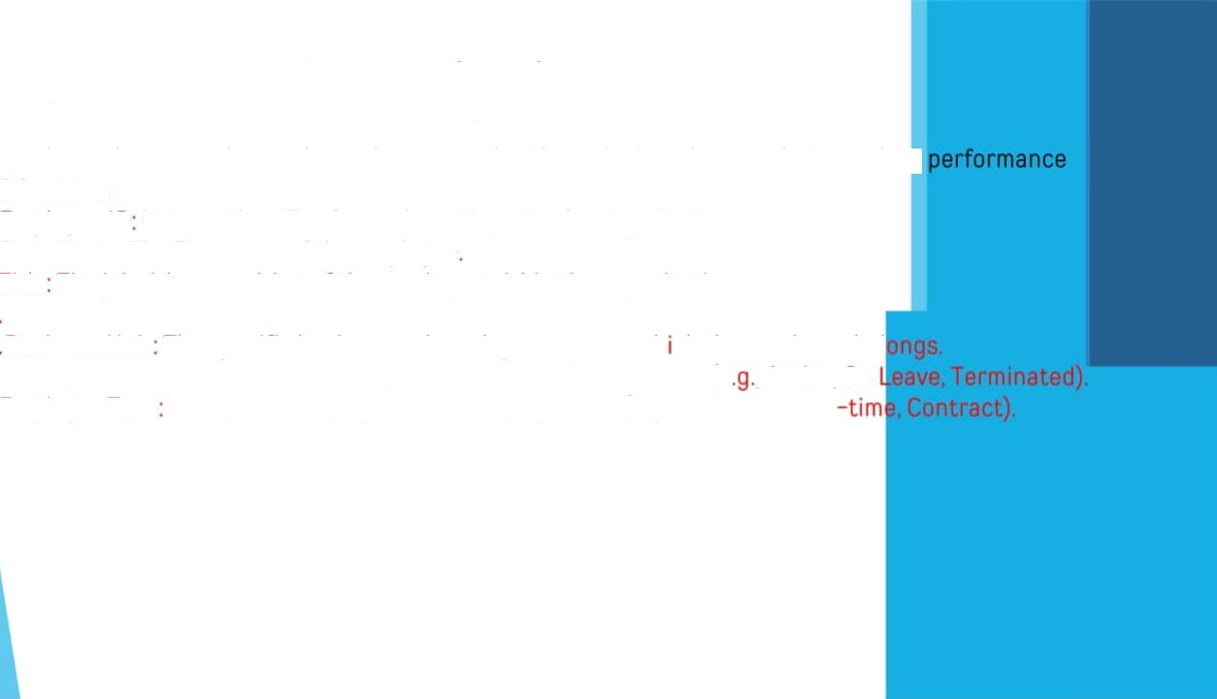
Dataset Description
Employee data set — the employee datas are taken from the Kaggle to analysis employe
9 features
Employee ID Unique identifier for eacn employee in tne organization First Name: The first name of the employee
Title the job title or positi on of the employee within the organization
Business Unit The speci fic ousiness unit or department to wh ch the employee oel Employee Status: The current employment status of tne employee (e , Active. On Employee Type The type of employment ltte emoloyee has (e g.. Full—time, Part

Slide 9
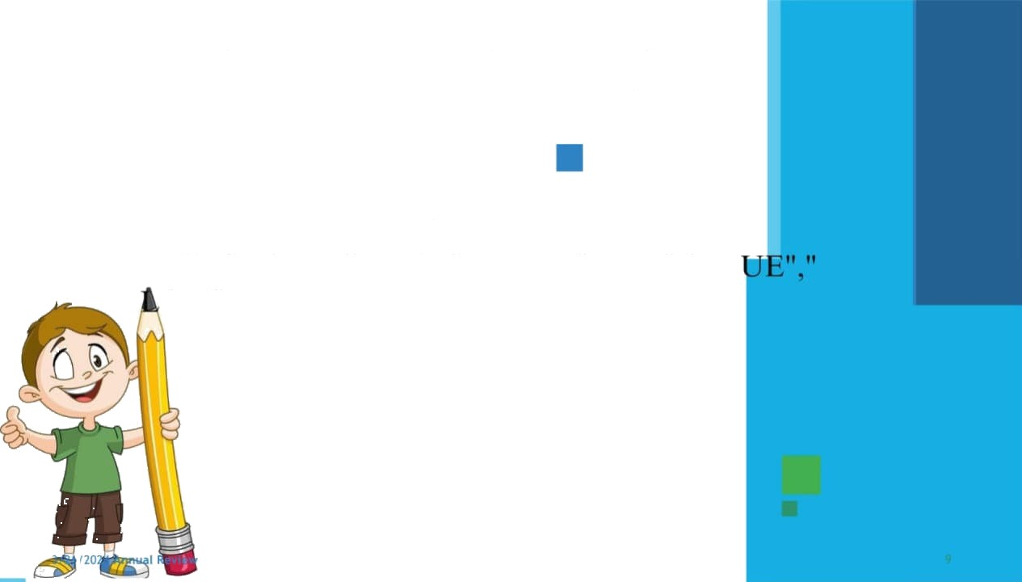
THE "WOW" IN OUR SOLUTION
=I FS(Z30>=5,”VERY
H IGH",Z30>=4"HIGH",ZJ0>=J"MED","TR OW"

Slide 10

MODELLING
Data collection
The employee performance analysis table are taken from the website called Kag
From the data we had some missing figures to identify the missing terms we use
conditional techniques to identify the missing terms like exit data etc.. Tnen we used filtering and sorting to fill the missing figues
Features collection
Pivot table
Charts
Conditional formatting

Slide 11

Pivot table
Click insert
From the insert bar click pivot table in new excel sheet
Select business unit and drag it in row
Then select performance level and drag it in column
Select gender in value
Performance|evel
From the pivot table we can see the analysis for female male and all and we can a type of employees by inerting slicers to see how many are full time ,part time and contract based employees.
Insert graph for better analysis the graph shows the accurate levels and the
performance of employees. We can see the various graph by changing the option graph options.

Slide 12
RESULT
S 70.0

Slide 13
Pie chart for high level performance

Slide 14

CORCluSiOR
From the above analysis the low IeveI,medium level to be improved by assigning various tasks and training in thei field
The current high and very high level employees are
improve their intensity by rewards and appreciations towards their growth to increase their participation a to give more potential towards their project.

